Slide 1

Analysis of Hotel Booking Cancellation Rate
Awalsyah Rinanto Putra
Data Analyst/Data Scientist

Slide 2
Click here to access the dataset and source code

Slide 3
TABLE OF CONTENTS
01
02
Data Preparation
Hotel Booking Cancelation Rate Analysis
- Missing values handling.
- Invalid values handling.
Based on:
Date
Stay Duration
Lead Time

Slide 4
01
Data Pre-Processing
- Missing values handling
- Invalid values handling

Slide 5
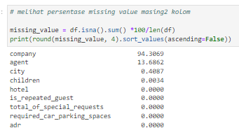
Missing Values Handling
Company: remove columns because too many missing values (94.3%)
Agent: fill with 0, because our assumption null values indicated customer booked the hotel without agent
City: fill with mode.
Children: fill with mode

Slide 6
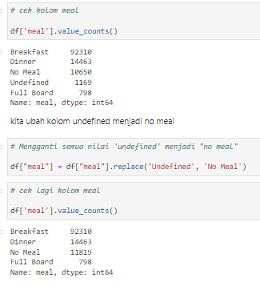
Invalid Values Correcting
Meal features:
change ‘Undefined’ to ‘No Meal’

Slide 7

Invalid Values Correcting
Adult features:
Remove adults with number of 0 because it didn’t make sense to book hotel without adults

Slide 8
02
Hotel Booking Cancellation Rate Analysis

Slide 9
Hotel Booking Cancellation Rate
Based on Date and Hotel Type

Slide 10
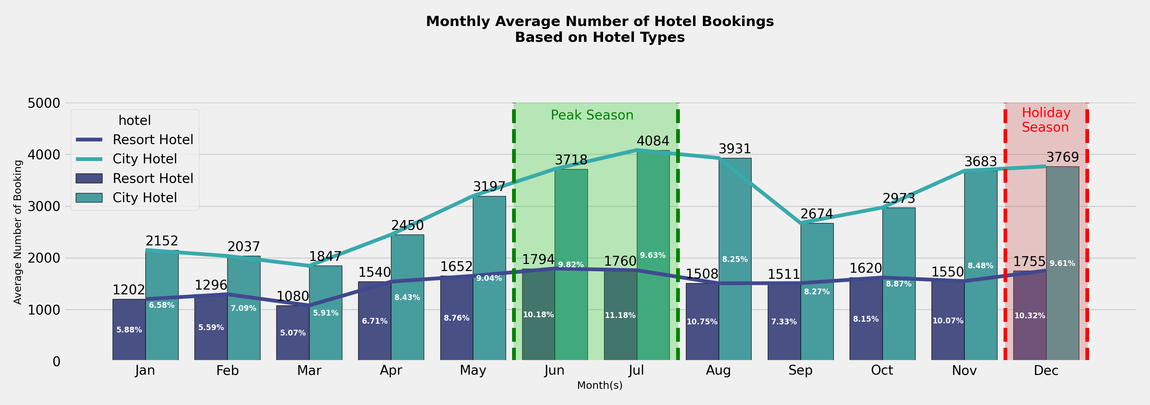
1. June and July are peak season for hotel bookings, this high number could be caused by long semester holiday.
2. City hotel reached highest average number of hotel bookings at 11.18% on july and resort hotel reached 9.82% on june
3. There're another growth on average number of hotel bookings in december for city hotel (10.32%) and resort hotel (9.61%).It could be cause by christmas and new year's eve holiday.

Slide 11
Hotel Booking Cancellation Rate
Based on Stay Duration

Slide 12
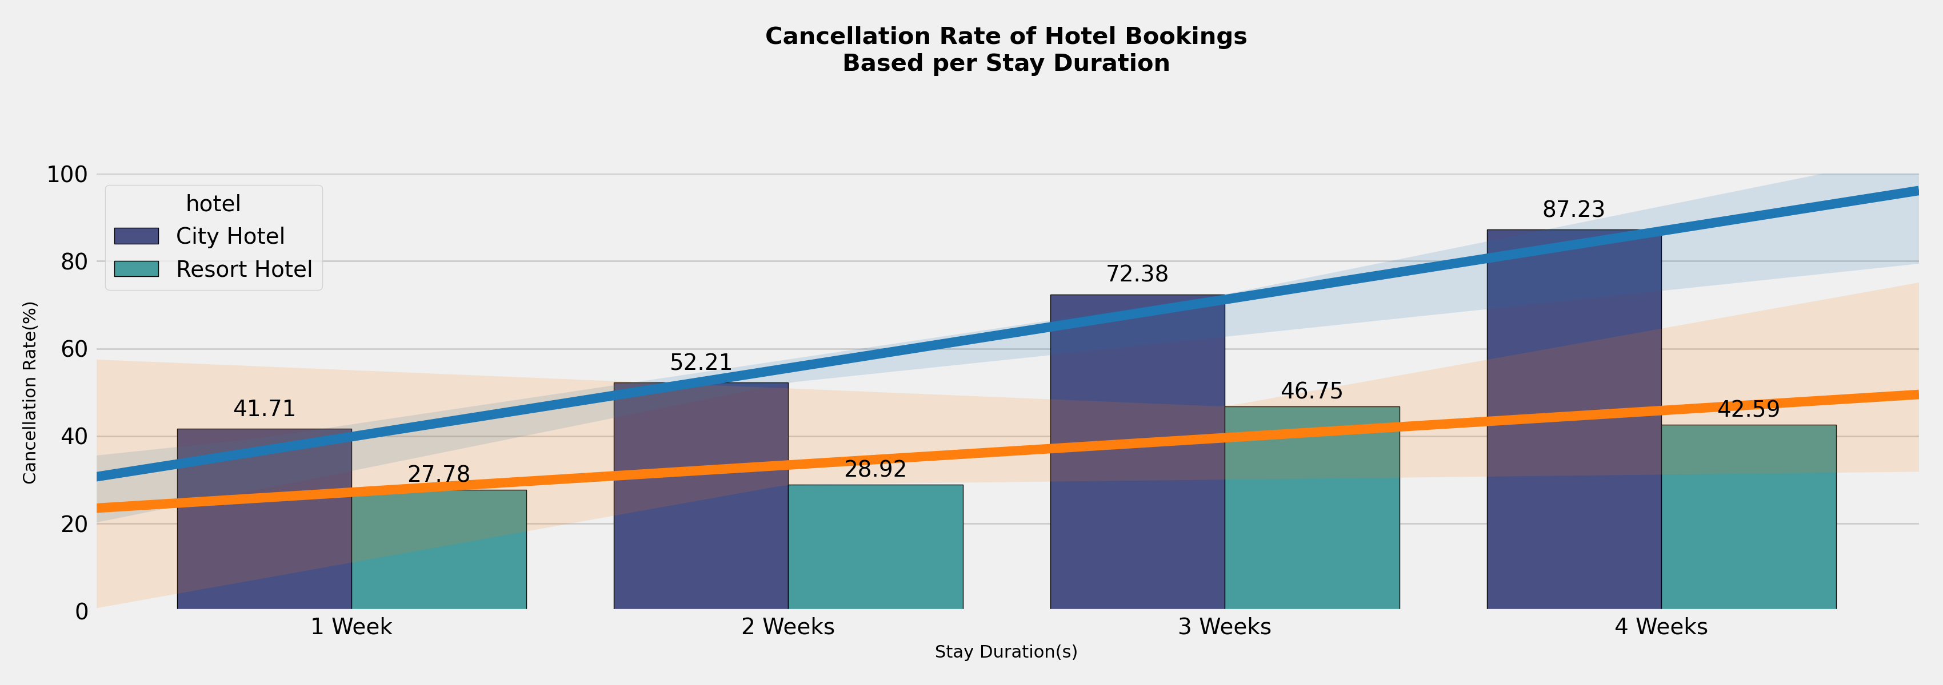
Impact Analysis of Stay Duration on Hotel Bookings Cancellation Rates
The longer customer stayed, the higher the percentage of booking being canceled.
The most canceled hotel bookings on city hotel was on four weeks stay duration (87.23%).
- The most canceled hotel bookings on resort hotel was on three weeks stay duration (46.75%).

Slide 13
Hotel Booking Cancellation Rate
Based on Lead Time

Slide 14
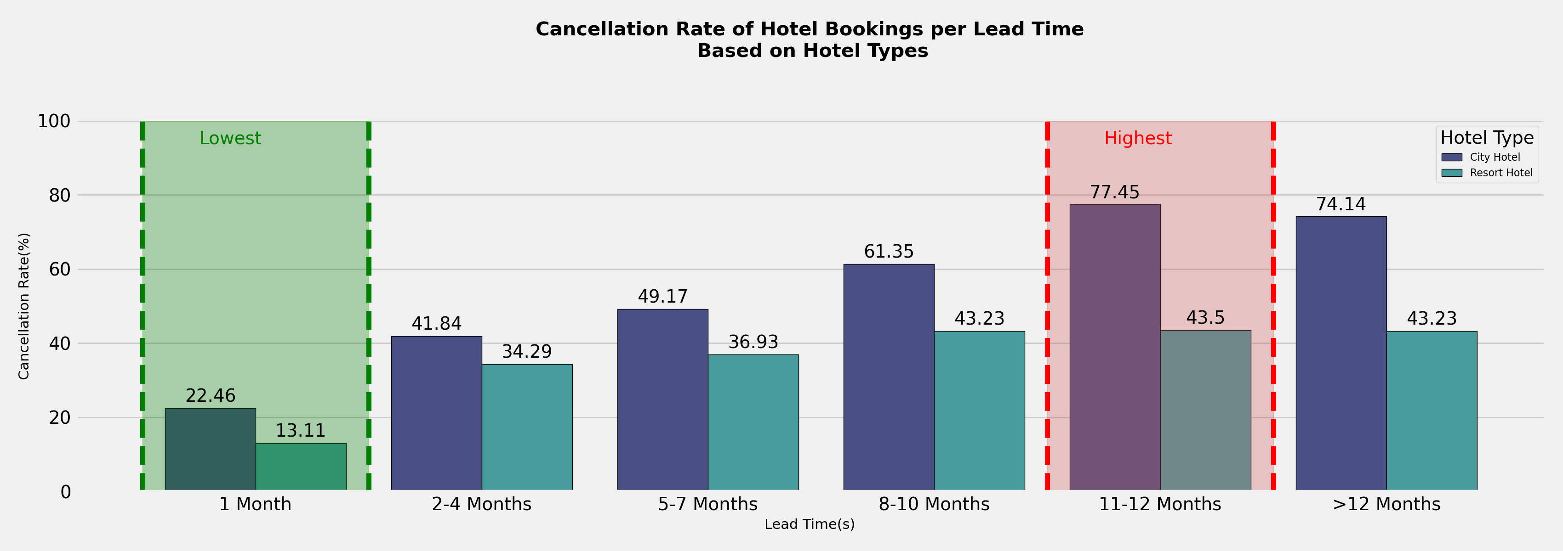
Impact Analysis of Stay Duration on Hotel Bookings Cancellation Rates
- Both hotel types has lowest cancellation rate on 1 month lead time (city = 22.46%; resort = 13.11%).
- The highest cancellation rate on 11-12 months lead time (city = 77.41%; resort = 43.5%).

Slide 15
Thank you
awalsyahrp@gmail.com
+62821 1393 2861
linkedin.com/in/awalsyahrp/
github.com/Awalsyah1995
Visit my repository to access the source code and dataset

